Slide 1
Price Prediction Using Machine Learning
Introduction to Regression
Importing Data, Data Cleaning, Pre-processing
Training and Testing
Abdullah Aziz
AI Sciences Instructor

Slide 2
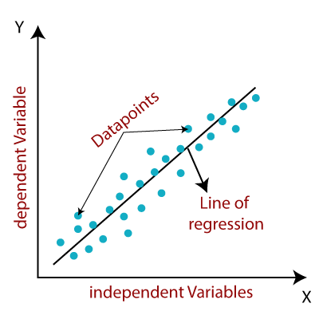
Regression
Used for predicting continuous values
Can be linear as well as non-linear
Independent variables can be more than one

Slide 3
Hands on Practice
Importing libraries and dependencies
Loading dataset and preprocessing
Model fitting
Evaluation
Conclusion

